Slide 1

Operating Systems
Lecture : 6

Slide 2

Graphical User Interfaces (GUI),
Command Line Interface(CLI),
Touch Screen Interface

Slide 3

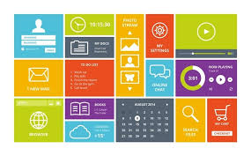
What is Graphical User Interface (GUI)
GUI stands for Graphical User Interface. It is a type of user interface that allows users to interact with electronic devices through graphical icons and visual indicators, as opposed to text-based interfaces, typed command labels, or text navigation.

Slide 4

Key Elements of GUI
Windows: Rectangular areas of the screen used to display the output of an application.
Icons: Small images or symbols that represent programs, files, functions, or commands.
Menus: Lists of options or commands that users can select from.
Buttons: Clickable elements that perform a specific action when clicked.

Slide 5
Key Elements of GUI(Cont.)
Toolbars: Sets of buttons or icons grouped together to provide easy access to frequently used commands or tools.
Text Boxes: Areas where users can input text.
Scroll Bars: Tools that allow users to move up, down, or across the screen to view content that does not fit within the window.

Slide 6
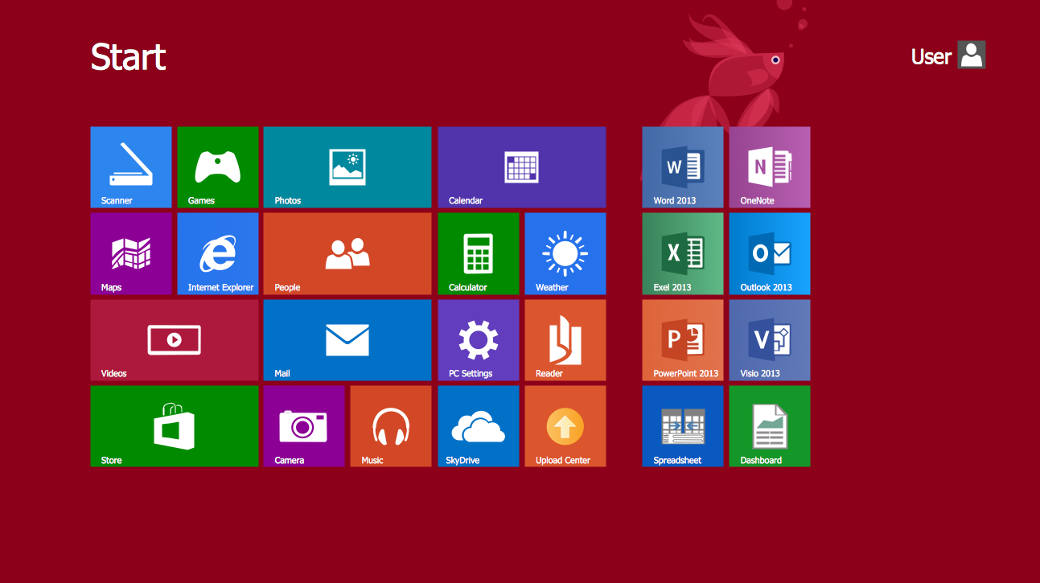

Slide 7
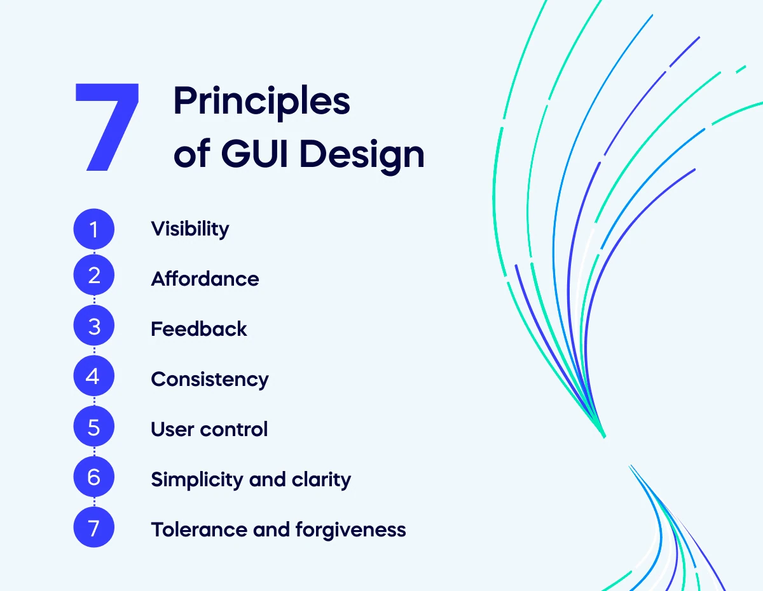

Slide 8
Advantages of GUI
User-Friendly: Intuitive and easy to use, especially for beginners.
Visual Appeal: Attractive and visually engaging, improving user experience.
Efficiency: Quick access to functions and features through icons and menus.
Reduced Learning Curve: Easier to learn compared to text-based interfaces.
Accessibility: Enhanced usability for users with disabilities through features like screen readers and magnifiers.

Slide 9
Advantages of GUI (cont.)
Consistency: Standardized interface elements across different applications and systems.
Error Reduction: Decreases the likelihood of errors by providing visual cues and feedback.
Multitasking: Supports multiple open windows, allowing users to switch between tasks easily.
Interactive: Provides immediate visual feedback, improving interactivity.

Slide 10
Disadvantages of GUI
Resource Intensive: Requires more system resources like memory and processing power.
Complexity: Can become complex with many features and options, potentially overwhelming users.
Slower for Experienced Users: Can be slower than command-line interfaces for experienced users who prefer typing commands.
Development Time: More time-consuming and costly to design and develop compared to simpler interfaces.
Hardware Dependency: Requires compatible hardware such as a mouse, graphics card, and high-resolution display.

Slide 11
Disadvantages of GUI (cont.)
Less Control: Provides less control over the system for advanced users who need to perform complex tasks.
Performance Issues: Can lead to performance issues on older or less powerful devices.
Software Bloat: Often includes many features that some users may never use, leading to unnecessary complexity.
Security Risks: Visual elements can sometimes mask underlying security issues or make it easier to execute malicious code.

Slide 12
Explain and demonstrate knowledge of the Command Line Interface (CLI)

Slide 13
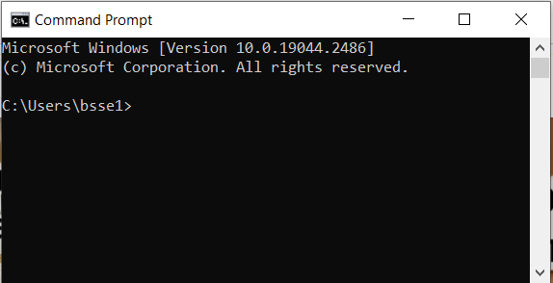
What is CLI?
The Command Line Interface (CLI) is a text-based interface for interacting with computer systems.
Instead of using a graphical user interface (GUI), users enter text commands to perform tasks and receive output in the form of text.

Slide 14
Concepts Related to CLI
Prompt: The CLI displays a prompt, indicating that the system is ready to receive commands. The prompt typically includes information such as the current directory, the username, and the hostname.
Commands: Commands are the text instructions that are entered into the CLI to perform specific tasks. For example, “ls” is for listing the contents of a directory
Options: Many commands have options that modify their behavior. Options are specified by adding a “-” or “--” before the option name. For example, the “ls” command can be run with the -l option to display the contents of a directory in a long format.

Slide 15
Concepts Related to CLI (cont.)
Arguments: Arguments are additional pieces of information that are passed to a command to specify what it should operate on. For example, the “cd” command can be followed by a directory name to specify which directory to change to.
Piping: Piping allows the output of one command to be used as the input of another command. This is done by using the “|” symbol to connect two commands. For example, the “ls” command can be piped to the “grep” command to search for a specific file in the list of files.
Tab completion: Most CLIs support tab completion, which allows users to easily complete commands, file and directory names, and options by pressing the tab key.

Slide 16
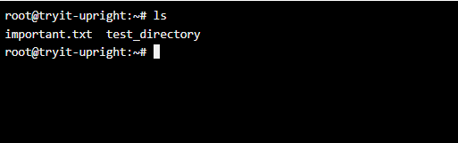
Common Commands
ls - lists the contents of a directory

Slide 17
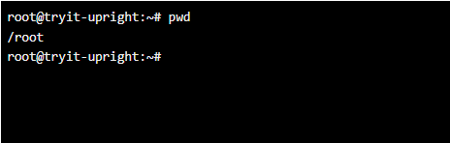
Common Commands (cont.)
pwd - displays the current working directory.

Slide 18
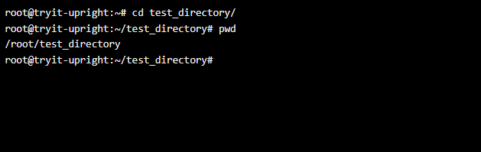
Common Commands (cont.)
cd - changes the current working directory.

Slide 19
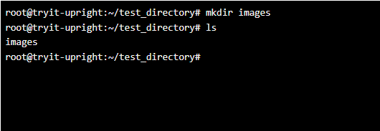
Common Commands (cont.)
mkdir - creates a new directory.

Slide 20
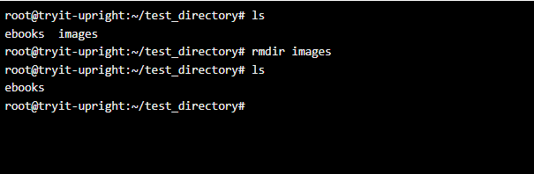
Common Commands (cont.)
rmdir - removes an empty directory.

Slide 21

Common Commands (cont.)
touch - creates a new file.

Slide 22
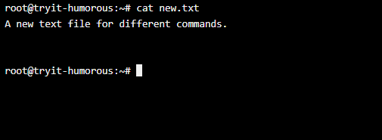
Common Commands (cont.)
cat - displays the contents of a file.

Slide 23
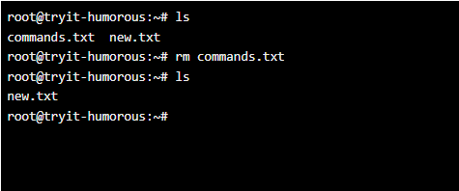
Common Commands (cont.)
rm - deletes a file.

Slide 24
Advantages of CLI
Speed and Efficiency: CLI allows users to perform tasks quickly and efficiently, especially when compared to GUI-based tools.
Automation: CLI commands can be easily combined and automated, making it a valuable tool for system administrators and developers.
Consistency: CLI commands have a consistent syntax and structure, making it easier for users to learn and use new commands.

Slide 25
Disadvantages of CLI
Requires users to learn and remember specific commands and syntax.
Can be intimidating for beginners or non-technical users.
Commands and options are not visible, making it harder to explore available features.
Users must rely on documentation or prior knowledge.
No immediate visual confirmation of actions, which can be less user-friendly.
Entering and remembering complex commands can be time-consuming compared to point-and-click interfaces.

Slide 26
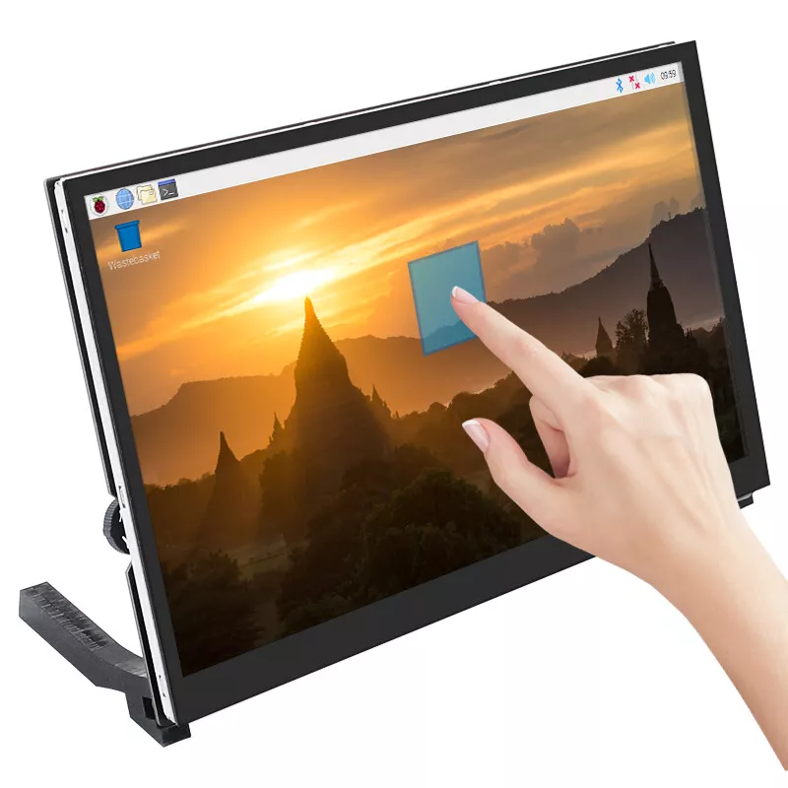
Touchscreen Interfaces
Touchscreen devices require new interfaces
Mouse not possible or not desired
Actions and selection based on gestures
Virtual keyboard for text entry
Voice commands.

Slide 27
Summary Between the Interfaces
GUI: Best for general users who need an intuitive, easy-to-navigate interface with visual feedback and multitasking capabilities.
CLI: Ideal for advanced users who require efficiency, precision, and the ability to automate tasks with minimal resource usage.
Touch Screen: Excellent for mobile devices and applications where intuitive, direct interaction with the display is beneficial, but can suffer from durability and precision issues.

Slide 28
Advantages of Touchscreen Interfaces
Intuitive Interaction: Users find touch screens natural and intuitive to use, especially for tasks like tapping, swiping, and pinch-to-zoom.
Accessibility: Simplifies interaction for users with disabilities who may find traditional input devices challenging.
Space Efficiency: Eliminates the need for separate input devices like keyboards and mice, saving space and reducing clutter.
Multi-touch Capability: Supports gestures for multi-touch input, enabling advanced functionalities like zooming and rotating.
Quick Response: Offers immediate feedback with fast response times, enhancing user experience in interactive applications.

Slide 29
Disadvantages of Touchscreen Interfaces
Fingerprint Smudges: Prone to fingerprints and smudges, which can obscure visibility and require frequent cleaning.
Accuracy Issues: May have limitations in precision compared to traditional input devices like a mouse , affecting detailed tasks.
Durability Concerns: Susceptible to scratches, cracks, and wear over time, particularly for devices used in rough environments.
Fatigue with Prolonged Use: Holding arms up for extended periods can lead to user fatigue, especially in desktop touch screen setups.
Cost: Generally more expensive to implement touch screens compared to traditional displays, adding to device costs.

Slide 30

Let’s do some exercises!

Slide 31
Exercises
Compare and contrast the User Interface (UI) and Command Line Interface (CLI). Discuss the strengths and weaknesses of each, and give examples of when it is appropriate to use each type of interface.
Divide in 2 groups and discuss the advantages and disadvantages of using Command Line Interfaces (CLI) in a professional setting, such as in a development environment or system administration.
Define what a User Interface (UI) is and explain its purpose.
Explain the importance of consistency in UI design and give an example of how this can be achieved.
Discuss the role of visual design in UI, including color, typography, and layout.

Slide 32
Exercises (cont.)
6. Explain the importance of providing clear and concise instructions to users in a UI and give an example of how this can be done.
7. Describe the difference between a good and bad UI and provide examples of each.
8. Discuss the role of accessibility in UI design, including the importance of making interfaces usable for people with disabilities.
9. Explain the importance of providing immediate feedback to users in a UI and give an example of how this can be done.
10. Discuss the importance of simplicity and ease of use in UI design and explain how this can be achieved.

Slide 33
Exercises (cont.)
11. What is the purpose of the CLI?
12. Explain the basic structure and syntax of a CLI command, including options and arguments.
13. Discuss the advantages and disadvantages of using a CLI, including its strengths and limitations compared to other types of interfaces.
14. What is the difference between a Unix-based and Windows-based CLI?
15. Explain the purpose of the following CLI commands: ls, cd, pwd, mkdir, rmdir, touch, rm, cat
16. How would you create a new file using the CLI?
17. How would you delete a file using the CLI?
18. How would you show the content of a file?

Slide 34
Exercises (cont.)
19. Suppose you are a system administrator and need to install software updates on a large number of servers. Which interface would be more efficient to use, the CLI or GUI? Why?
20. Suppose you are a data analyst and need to perform a series of complex data manipulations on a large dataset. Which interface would be more appropriate to use, the CLI or GUI? Why?
21. Suppose you are a web developer and need to quickly check the syntax of an HTML file. Which interface would you use, the CLI or GUI? Why?
22. Suppose you are a graphic designer and need to resize a large number of images. Which interface would be more efficient to use, the CLI or GUI? Why?
23. Suppose you are a network engineer and need to monitor the performance of a network in real-time. Which interface would you use, the CLI or GUI? Why?

Slide 35

Thanks!

